Slide 1
REAL ESTATE
Houses price predictions
By Ahmed Aloliwi

Slide 2
TABLE OF CONTENTS
01
02
03
Goal of this project
Selecting the data source
04
05
06
Data cleaning and exploration
Testing and training the models
Tools and techniques
Conclusion

Slide 3
Goal of this project
The main objective of this project is to help us create a ML model to predict housing unit prices.
Dubai has been chosen as one of the most developed cities in the region. The existence of such models will be reflected in creating confidence in the real estate market and reassurance with the buyer and seller from the existence of illogical and understandable fluctuations in real estate prices.
Dubai
REAL ESTATE

Slide 4
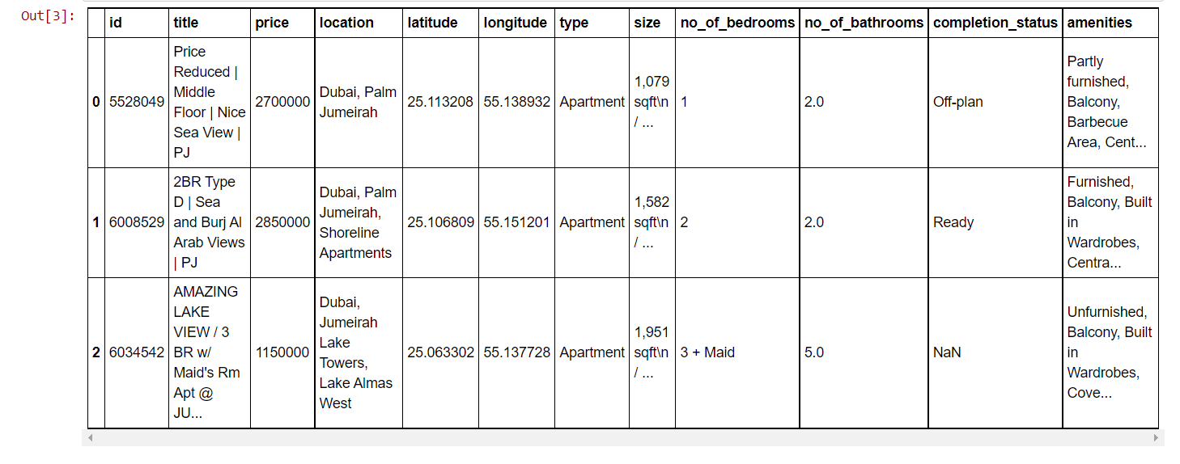
Selecting the data source
I tried looking for data on different sites like Github and Kaggle I chose a semi-clean data from Kaggle site that includes about 2000 and after cleaning the data I have 1906 and 38 columns.

Slide 5
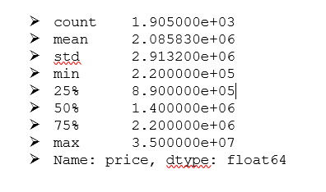
Data cleaning and exploration
For the cleaning stage:
Removing unwanted columns.
Removing duplicates.
For the exploration stage:
I looking to price analysis.

Slide 6
Data cleaning and exploration
Looking at descriptive analysis for property pricing in out dataset, we can say that:
- Property prices ranging from AED 220,000 to 35 Millions
- We have 1906 total properties in our dataset
- Mean price of our apartment is little over 2 Million AED
Our price distribution looks like:

Slide 7
Testing and training the models
I trained and tested three models and finally I select Randomforestregressor because it has high R2 score which was closest to one was 0.9923263147255801 compared to other models.
Model | R2 score
GradientBoostingRegressor | 0.991161083837371
RandomForestRegressor | 0.9923263147255801
XGBRegressor | 0.988561795411537

Slide 8
Tools and techniques
I used python packages for data science models like (sklearn, xgboost, etc.).
I used Google cloud Colab to write my python script.
Numpy and Pandas for data manipulation.
Scikit-learn for modeling.
Matplotlib and Seaborn for plotting.

Slide 9
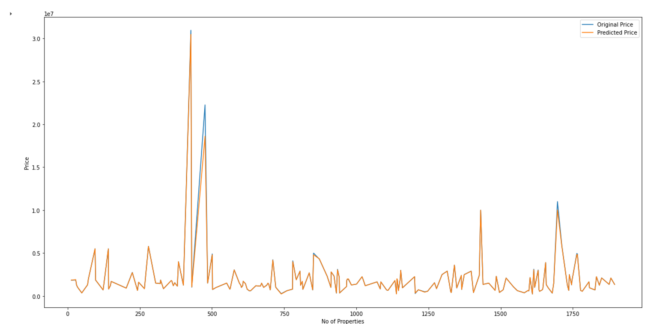
Conclusion
I think if I work with more and up-to-date data, it will help us get more accurate real estate price predictions

Slide 10
Thank You

